Slide 1
UNIT - IV
Memory Organization:
Memory Hierarchy
Main Memory
Auxiliary memory
Associate Memory
Cache Memory.
I/O interface:
I/O Bus and Interface modules, I/O versus Memory Bus.
Modes of Transfer:
Example of programmed I/O,
Interrupt-initiated I/O
Software considerations,
Daisy- Chaining priority.
DMA:
DMA Controller, DMA Transfer, Intel 8089 IOP.

Slide 2
Memory Organization:
The memory unit Is an essential component in any digital computer since It Is needed for storing programs and data.
The memory unit stores the binary information in the form of bits.
Generally, memory/storage is classified into 2 categories:
Volatile Memory:
This loses its data, when power is switched off.
Non-Volatile Memory:
This is a permanent storage and does not lose any data when power is switched off.

Slide 3
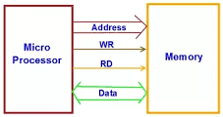

Slide 4
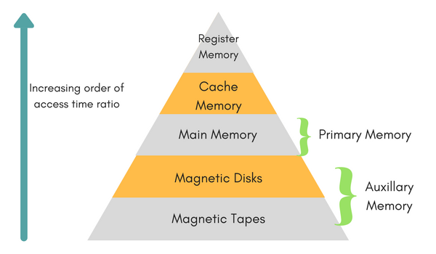
Memory Hierarchy

Slide 5
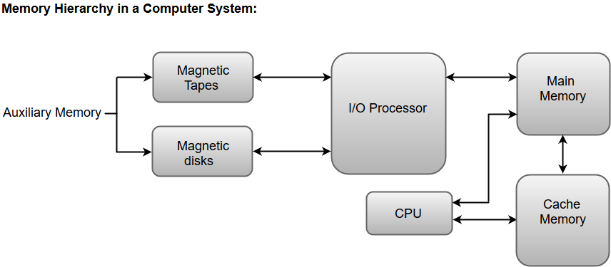
Memory Hierarchy in Computer System

Slide 6
Cache Memory:
The data or contents of the main memory that are used frequently by CPU are stored in the cache memory so that the processor can easily access that data in a shorter time. Whenever the CPU needs to access memory, it first checks the cache memory. If the data is not found in cache memory, then the CPU moves into the main memory.
A special very-high speed memory called a Cache is sometimes used to increase the speed of processing by making current programs and data available to the CPU at a rapid rate.
Cache memory is placed between the CPU and the main memory.

Slide 7
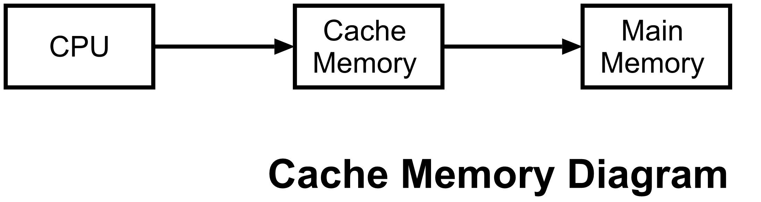
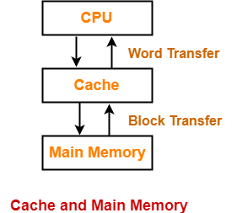

Slide 8
The cache is the fastest component in the memory hierarchy and approaches the speed of CPU components.
The basic operation of a cache memory is as follows:
When the CPU needs to access memory, the cache is examined. If the word is found in the cache, it is read from the fast memory.
If the word addressed by the CPU is not found in the cache, the main memory is accessed to read the word.
The performance of the cache memory is frequently measured in terms of a quantity called hit ratio.
When the CPU refers to memory and finds the word in cache, it is said to produce a hit.
If the word is not found in the cache, it is in main memory and it counts as a miss.
The ratio of the number of hits divided by the total CPU references to memory (hits plus misses) is the hit ratio.

Slide 9
Main Memory
The memory unit that communicates directly with the CPU is called the main memory.
Only programs and data currently needed by the processor reside in main memory.
Not all accumulated information is needed by the processor at the same time. Therefore, it is more economical to use low-cost storage devices to serve as a backup for storing the information that is not currently used by the CPU.
All other information Is stored in auxiliary memory and transferred to main memory when needed.

Slide 10
An Auxiliary memory:
An Auxiliary memory is known as
the lowest-cost,
highest-capacity and
slowest-access storage in a computer system.
It is where programs and data are kept for long-term storage or when not in immediate use.
The most common examples of auxiliary memories are magnetic tapes and magnetic disks.
Devices that provide backup storage are called auxiliary memory.
They are used for storing system programs, large data files, and other backup information.

Slide 11
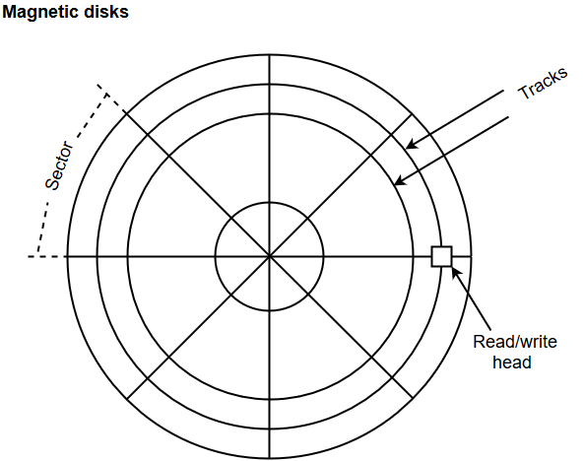

Slide 12
Auxiliary and cache memories are used for different purposes.
The cache holds those parts of the program and data that are most heavily used(frequently), while the auxiliary memory holds those parts that are not presently used by the CPU.
the CPU has direct access to both cache and main memory but not to auxiliary memory.

Slide 13
For example
a typical cache memory may have an access time of 100ns, while main memory access time may be 700ns. Auxiliary memory average access time is usually 1000 times that of main memory.
Block size in auxiliary memory typically ranges from 256 to 2048 words, while cache block size is typically from 1 to 16 words.

Slide 14
Associative Memory:
An associative memory can be considered as a memory unit whose stored data can be identified for access by the content of the data itself rather than by an address or memory location.
Associative memory is often referred to as Content Addressable Memory (CAM).

Slide 15
When a write operation is performed on associative memory, no address or memory location is given to the word. The memory itself is capable of finding an empty unused location to store the word.
On the other hand, when the word is to be read from an associative memory, the content of the word, or part of the word, is specified. The words which match the specified content are located by the memory and are marked for reading.

Slide 16
Input-Output Interface
Input-output interface provides a method for transferring information between internal storage and external I/O devices.
Peripherals connected to a computer need special communication links for interfacing them with the central processing unit.
The purpose of the communication link is to resolve the differences that exist between the central computer and each peripheral.

Slide 17
The major differences are:
1. Peripherals are electromechanical and electromagnetic devices and their
manner of operation is different from the operation of the CPU and memory, which are electronic devices. Therefore, a conversion of signal values may be required.
Electric bells and buzzers, Loudspeakers and headphones, Motors and generators, Transformers etc.
2. The data transfer rate of peripherals is usually slower than the transfer rate of the CPU, and consequently, a synchronization mechanism may be needed.
3. Data codes and formats in peripherals differ from the word format in the CPU and memory.
4. The operating modes of peripherals are different from each other and each must be controlled so as not to disturb the operation of other peripherals connected to the CPU.

Slide 18
To resolve these differences, computer systems include special hardware components between the CPU and peripherals to supervise and synchronize all input and output transfers.
These components are called interface units because they interface between the processor bus and the peripheral device.
In addition, each device may have its own controller that supervises the operations of the particular mechanism in the peripheral

Slide 19
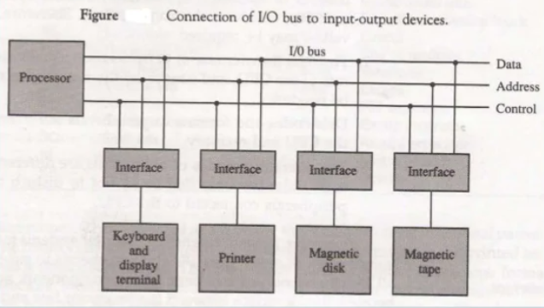
I/O Bus and Interface modules
11-1

Slide 20
A typical communication link between the processor and several peripherals is shown in above Figure.
The 1/O bus consists of data lines, address lines, and control lines.
The magnetic disk, printer, and keyboard and display terminal are employed in practically any general-purpose computer. The magnetic tape is used in some computers for backup storage.
Each peripheral device has associated with it an interface unit.

Slide 21
The I/O bus from the processor is attached to all peripheral interfaces.
To communicate with a particular device, the processor places a device address on the address lines.
Each interface attached to the I/O bus contains an address decoder that monitors the address lines.
When the interface detects its own address, it activates the path between the bus lines and the device that it controls.

Slide 22
All peripherals whose address does not correspond to the address in the bus are disabled by their interface.
At the same time that the address is made available In the address lines, the processor provides a function code in the control lines.
The interface selected responds to the function code and proceeds to execute it.

Slide 23
Interface:
Each interface decodes the “address and control” received from the I/O bus, interprets them for the peripheral, and provides signals for the peripheral controller.
It also synchronizes the data flow and supervises the transfer between peripheral and processor.
There are four types of commands that an interface may receive.
They are classified as control, status, data output, and data input.

Slide 24
A control command is issued to activate the peripheral and to inform it what to do.
Example, a magnetic tape unit may be instructed to backspace the tape by one record, to rewind the tape, or to start the tape moving in the forward direction.
The particular control command issued depends on the peripheral, and each peripheral receives its own distinguished sequence of control commands, depending on its mode of operation.

Slide 25
Controller
Each peripheral has its own controller that operates the particular electromechanical device.
Example, the printer controller controls the paper motion, the print timing, and the selection of printing characters.
A controller may be housed separately or may be physically integrated with the peripheral.

Slide 26
I/O versus Memory Bus
In addition to communicating with I/O, the processor must communicate with the memory unit.
Like the I/O bus, the memory bus contains data, address, and read/write control lines.
There are three ways that computer buses can be used to communicate with memory and I/O:
1. Use two separate buses, one for memory and the other for I/O.
2. Use one common bus for both memory and I/O but have separate control lines for each.
3. Use one common bus for memory and I/O with common control lines.

Slide 27
In the first method, the computer has independent sets of data, address, and control buses, one for accessing memory and the other for I/O.
This is done in computers that provide a separate I/O processor (IOP) in addition to the central processing unit (CPU).
The memory communicates with both the CPU and the IOP through a memory bus.

Slide 28
The IOP communicates also with the input and output devices through a separate I/O bus with its own address, data and control lines.
The purpose of the IOP is to provide an independent pathway for the transfer of information between external devices and internal memory.
The I/O processor is sometimes called a data channel.

Slide 29
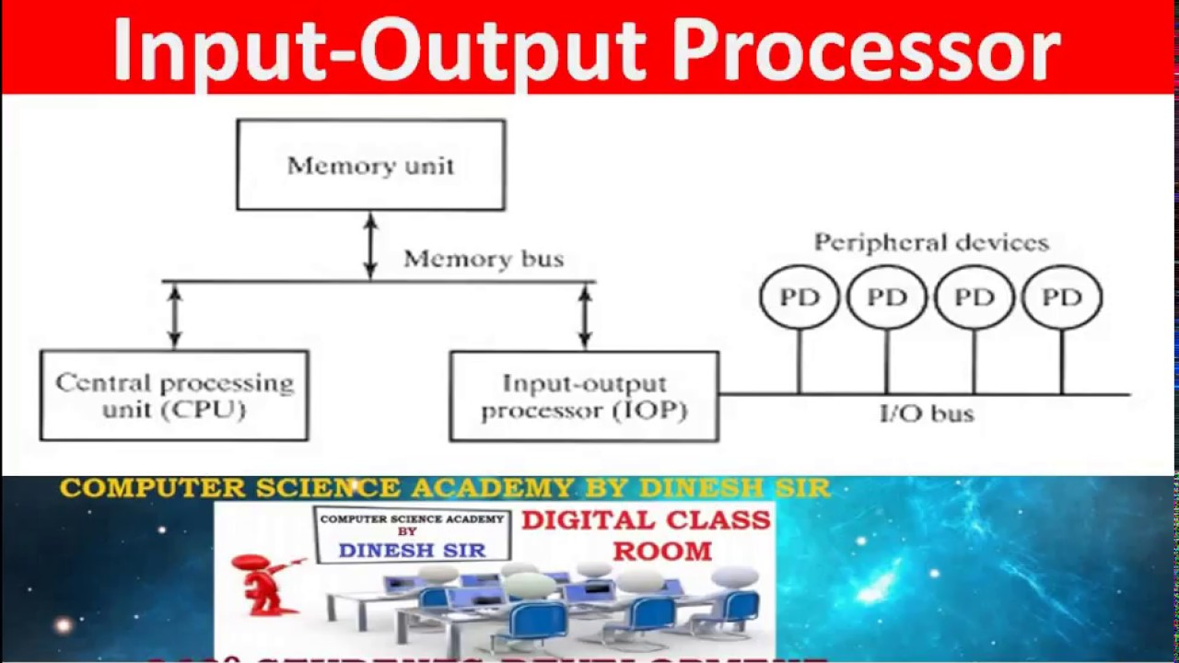

Slide 30
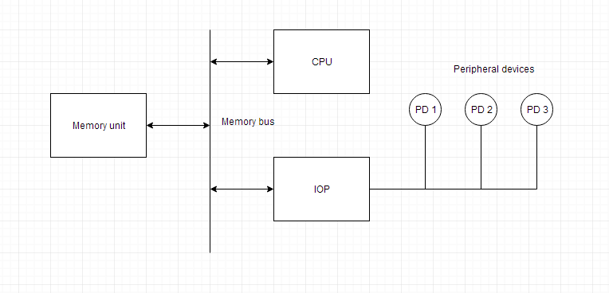

Slide 31
I/O Processor
It is a processor with direct memory access capabilities that means it has the ability to access the memory directly without the CPU involvement.
In this computer system is divided into memory unit and the no. of processors.
In Each I/O processor (IOP) control and manages the I/O task, means what are the control task coming from external devices that will be manage by I/O processer.
It can fetch and executes its own instructions received from either from peripherals or from the memory.
Memory occupies the central position and communicate with each processor (CPU and I/O processors).
The I/O Subsystem of the computer, provides an efficient mode of communication between the central system and the outside environment.

Slide 32
Why I/O Processor?
The DMA mode of data transfer reduces CPU’s overhead in handling I/O operations.
It also allows parallelism in CPU and I/O operations. Such parallelism is necessary to avoid wastage of valuable CPU time while handling I/O devices whose speeds are much slower as compared to CPU.
The concept of DMA operation can be extended to relieve the CPU further from getting involved with the execution of I/O operations. This gives rises to the development of special purpose processor called Input-Output Processor (IOP) or IO channel.
The Input Output Processor (IOP) is just like a CPU that handles the details of I/O operations. It is more equipped with facilities than those are available in typical DMA controller. The IOP can fetch and execute its own instructions that are specifically designed to characterize I/O transfers. In addition to the I/O – related tasks, it can perform other processing tasks like arithmetic, logic, branching and code translation. The main memory unit takes the pivotal role. It communicates with processor by the means of DMA.

Slide 33
CPU vs IOP
What is CPU?
Data required for solving the computational task, ALU.
What is I/O Processor(IOP)?
It provides a path to transfer data between peripherals and memory
acting as interface between peripheral and memory.
CPU assign the task to I/O processor or CPU initiate the I/O processor, (addition of two number program)
I/O processor operate independent from CPU.
Executes the instruction received from CPU and main memory

Slide 34
Master vs Slave Processor
Master processor: owner of the system bus or full control over the system bus or doing operations
Slave processor: whenever CPU hand over the system bus to any of the processor, then it is called slave processor doesn’t do anything.
Commands: I/O processor reads the instructions from memory or CPU or External devices (command word)
Command word prepare by the programmer
CPU inform the I/O processor to take the command word from the memory because to perform the operation (IOP will take command and execute it and inform the CPU that I have completed the assigned work by sending interrupt signals. And now CPU become the master.)

Slide 35
Isolated versus Memory-Mapped I/O
Many computers use one common bus to transfer information between memory or I/O and the CPU.
The distinction between a memory transfer and I/O transfer is made through separate read and write lines.
The CPU specifies whether the address on the address lines is for a memory word or for an interface register by enabling one of two possible read or write lines.

Slide 36
The I/O read and I/O write control lines are enabled during an I/O transfer.
The memory read and memory write control lines are enabled during a memory transfer.
This configuration isolates all I/O interface addresses from the addresses assigned to memory and is referred to as the isolated I/O method for assigning addresses in a common bus.
In the isolated I/O configuration, the CPU has distinct input and output instructions, and each of these instructions is associated with the address of an interface register.

Slide 37
When the CPU fetches and decodes the operation code of an input or output instruction, it places the address associated with the instruction into the common address lines. At the same time, it enables the I/O read (for input) or I/O write (for output) control line. This informs the external components that are attached to the common bus that the address in the address lines is for an interface register and not for a memory word.

Slide 38
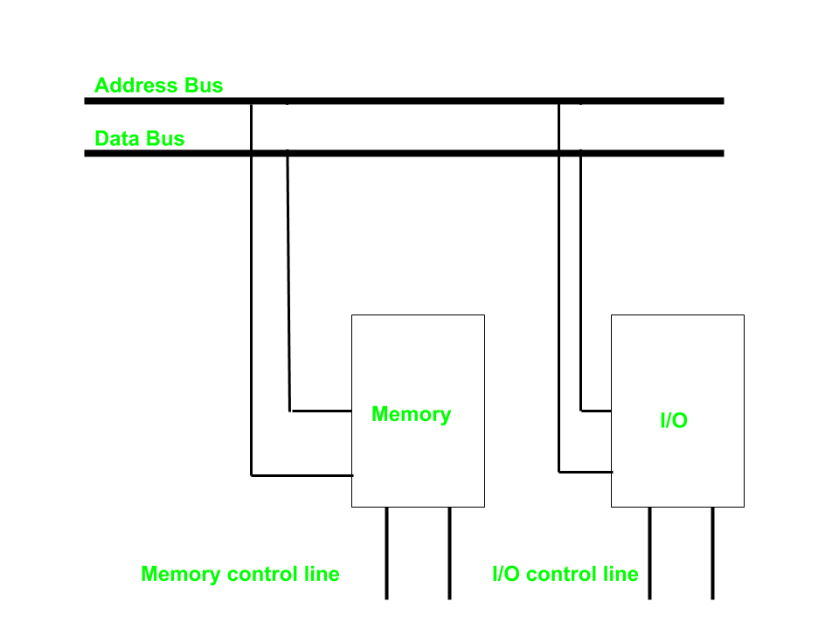

Slide 39
On the other hand, when the CPU is fetching an instruction or an operand from memory, it places the memory address on the address lines and enables the memory read or memory write control line. This informs the external components that the address is for a memory word and not for an I/O interface.

Slide 40
The isolated I/O method isolates memory and I/O addresses so that memory address values are not affected by interface address assignment since each has its own address space. The other alternative is to use the same address space for both memory and I/O.
This is the case in computers that employ only one set of read and write signals and do not distinguish between memory and I/O addresses. This configuration is referred to as memory-mapped I/O.
The computer treats an interface register as being part of the memory system. The assigned addresses for interface registers cannot be used for memory words, which reduces the memory address range available.

Slide 41
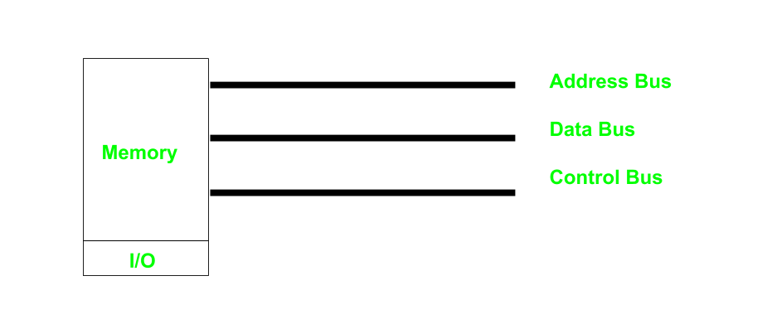

Slide 42
Computers with memory-mapped I/O can use memory-type instructions to access I/O data.
It allows the computer to use the same instructions for either input-output transfers or for memory transfers.
The advantage is that the load and store instructions used for reading and writing from memory can be used to input and output data from I/O registers

Slide 43
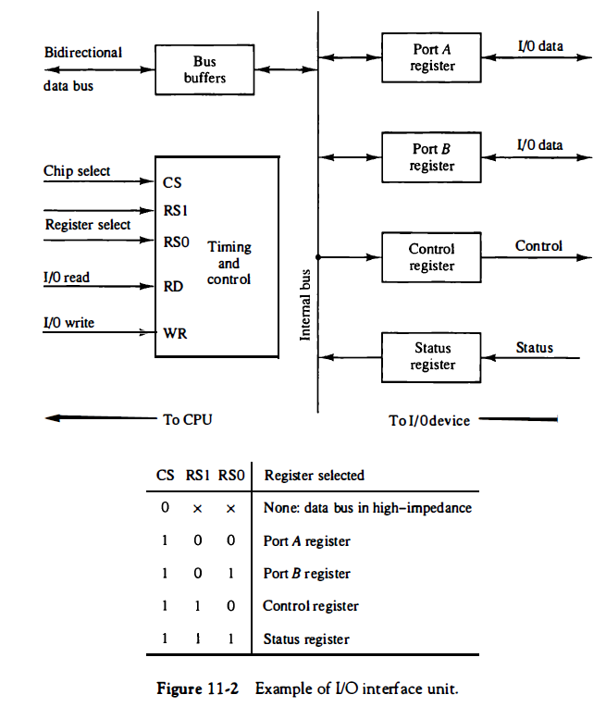

Slide 44
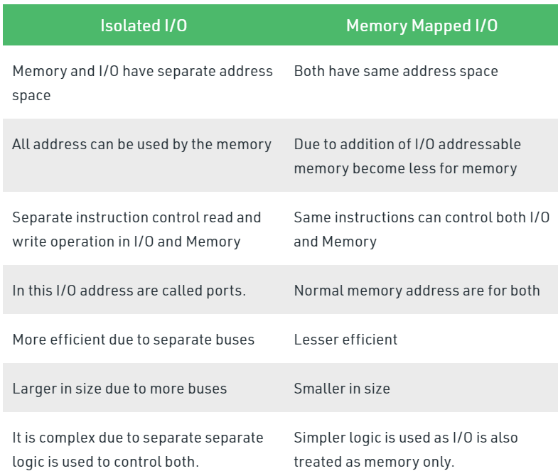

Slide 45
Modes of Transfer:
Example of programmed I/O,
interrupt-initiated I/O
software considerations,
Daisy- Chaining priority.

Slide 46
Transfer : flow of information between internal storage(memory) and external I/O devices (peripherals)
special communication links: These communication links are used to resolve the differences between CPU and peripheral.
interface units: special hardware components between CPU and peripherals to supervise and synchronize all the input and output transfers.

Slide 47
Modes of Transfer:
The binary information that is received from an external device is usually stored in the memory unit.
The information that is transferred from the CPU to the external device is originated from the memory unit.
CPU merely processes the information but the source and target is always the memory unit.

Slide 48
Data transfer between CPU and the I/O devices may be done in different modes.
Programmed I/O.
Interrupt- initiated I/O.
Direct memory access( DMA).
Some modes use the CPU as an intermediate path; others transfer the data directly to and from the memory unit.

Slide 49
Programmed I/O:
The programmed I/O was the most simple type of I/O technique for the exchanges of data or any types of communication between the processor and the external devices.
It is due to the result of the I/O instructions that are written in the computer program.
Each data item transfer is initiated by an instruction in the program.
Usually the transfer is from a CPU register and memory.

Slide 50
In this case it requires constant monitoring by the CPU of the peripheral devices.
When the processor issues a command to the I/O module, it must wait until the I/O operation is complete. If the processor is faster than the I/O module, this is wasteful of processor time.

Slide 51
In the programmed I/O method, the I/O device does not have direct access to memory.
A transfer from an I/O device to memory requires the execution of several instructions by the CPU, including an input instruction to transfer the data from the device to the CPU and a store instruction to transfer the data from the CPU to memory.
Other instructions may be needed to verify that the data are available from the device and to count the numbers of words transferred.

Slide 52
The overall operation of the programmed I/O
The processor is executing a program and encounters an instruction relating to I/O operation.
The processor then executes that instruction by issuing a command to the appropriate I/O module.
The I/O module will perform the requested action based on the I/O command issued by the processor (READ/WRITE) and set the appropriate bits in the I/O status register.
The processor will periodically check the status of the I/O module until it find that the operation is complete.

Slide 53
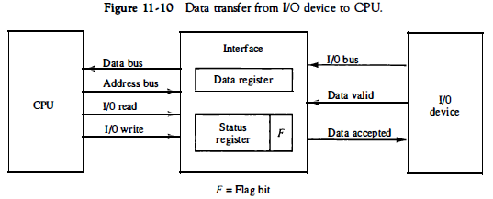

Slide 54
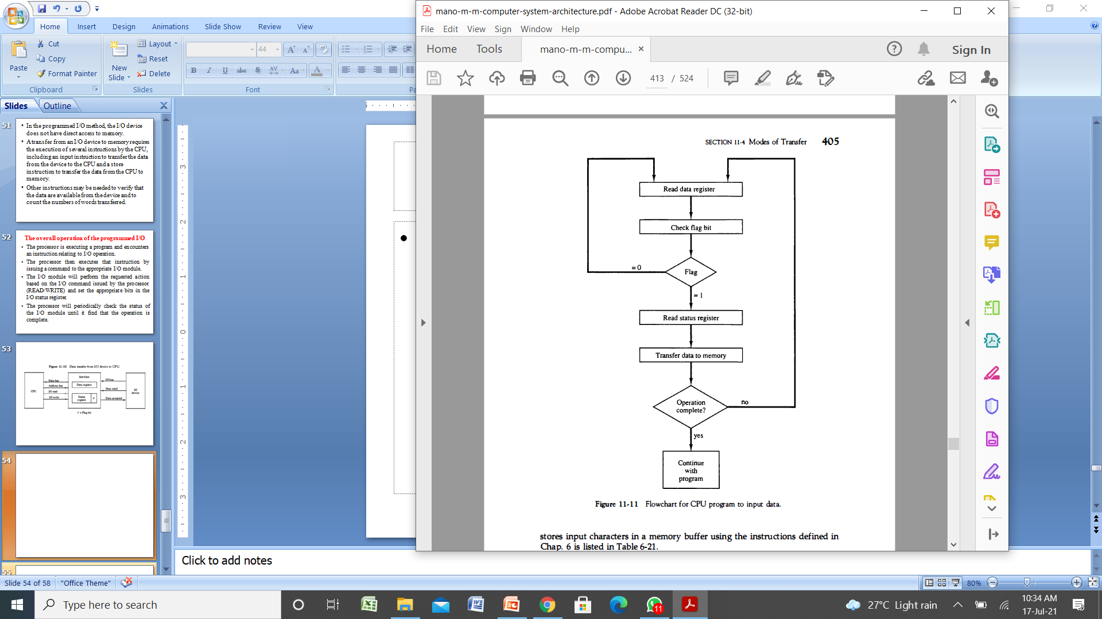

Slide 55
The programmed I/O method is particularly useful in small low-speed computers
OR
in systems that are dedicated to monitor a device continuously.

Slide 56
Interrupt-initiated I/O
Data transfer between the CPU and an I/O device is initiated by the CPU.
However, the CPU cannot start the transfer unless the device is ready to communicate with the CPU.
The readiness of the device can be determined from an interrupt signal.
An alternative to the CPU constantly monitoring the flag is to let the interface inform the computer when it is ready to transfer data.
This mode of transfer uses the interrupt facility.
While the CPU is running a program, it does not check the flag.

Slide 57
However, when the flag is set, the computer is momentarily interrupted from proceeding with the current program and is informed of the fact that the flag has been set.
The CPU deviates from what it is doing to take care of the input or output transfer.
After the transfer is completed, the computer returns to the previous program to continue what it was doing before the interrupt.

Slide 58
The CPU responds to the interrupt signal by storing the return address from the program counter into a memory stack and then control branches to a service routine that processes the required I/O transfer.
The way that the processor chooses the branch address of the service routine varies from one unit to another.

Slide 59
In principle, there are two methods for accomplishing this.
One is called vectored interrupt and the other, non vectored interrupt.
In a non vectored interrupt, the branch address is assigned to a fixed location in memory.
In a vectored interrupt, the source that interrupts supplies the branch information to the computer. This information is called the interrupt vector.
In some computers the interrupt vector is the first address of the I/O service routine.
In other computers the interrupt vector is an address that points to a location in memory where the beginning address of the I/O service routine is stored.

Slide 60
Software Considerations
The previous discussion was concerned with the basic hardware needed to interface I/O devices to a computer system.
A computer must also have software routines for controlling peripherals and for transfer of data between the processor and peripherals.
I/O routines must issue control commands to activate the peripheral and to check the device status to determine when it is ready for data transfer.
Once ready, information is transferred item by item until all the data are transferred.

Slide 61
In some cases, a control command is then given to execute a device function such as stop tape or print characters. Error checking and other useful steps often accompany the transfers.
In interrupt-controlled transfers, the I/O software must issue commands to the peripheral to interrupt when ready and to service the interrupt when it occurs.
In DMA transfer, the I/O software must initiate the DMA channel to start its operation.

Slide 62
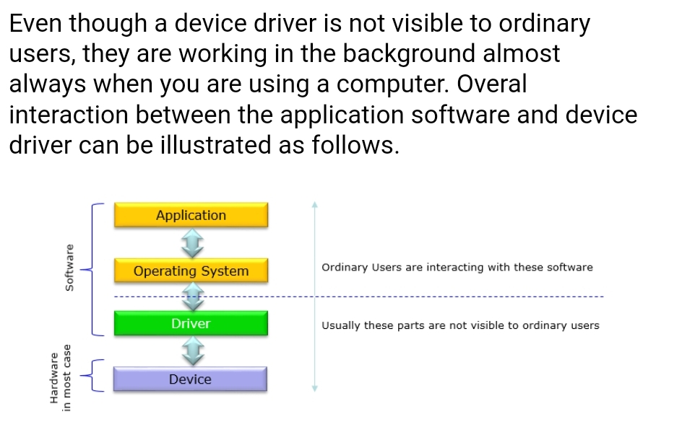

Slide 63
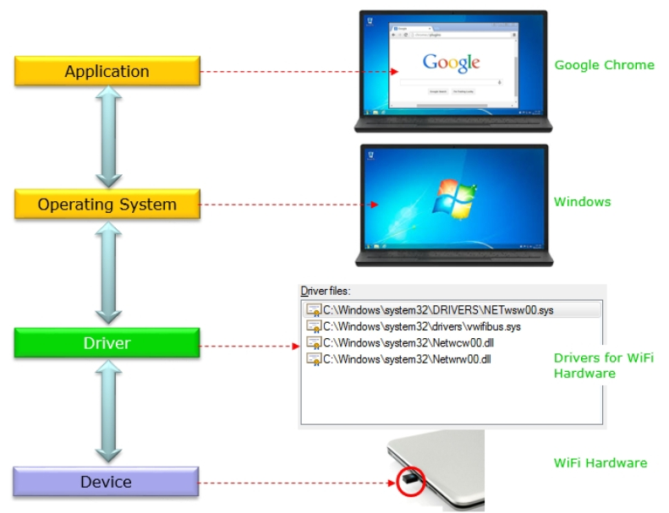

Slide 64
Daisy- Chaining priority
The hardware priority function can be established by either a serial or a parallel connection of interrupt lines.
The serial connection is also known as the Daisy chaining method.
The daisy-chaining method of establishing priority
a serial connection(Low speed transmission) of all devices that request an interrupt.
The device with the highest priority is placed in the first position, followed by lower-priority devices up to the device with the lowest priority, which is placed last in the chain.

Slide 65
In a typical application a number of I/O devices are attached to the computer, with each device being able to originate an interrupt request.
The first task of the interrupt system is to identify the source of the interrupt.
There is also the possibility that several sources will request service simultaneously.
In this case the system must also decide which device to service first.

Slide 66
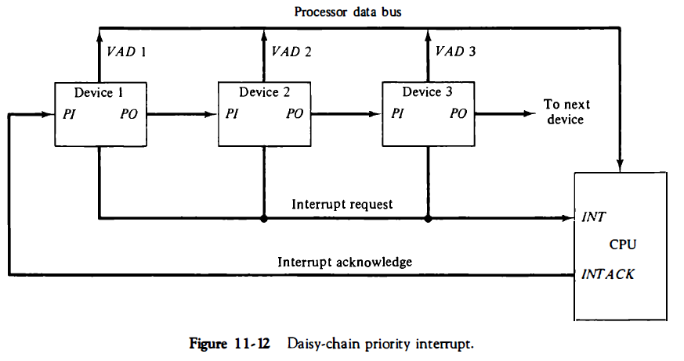
The interrupt request line is common to all devices and forms a wired logic connection.
If any device has its interrupt signal in the low-level state, the interrupt line goes to the low-level state and enables the interrupt input in the CPU.
When no interrupts are pending, the interrupt line stays in the high-level state and no interrupts are recognized by the CPU.
The CPU responds to an interrupt request by enabling the interrupt acknowledge line.

Slide 67
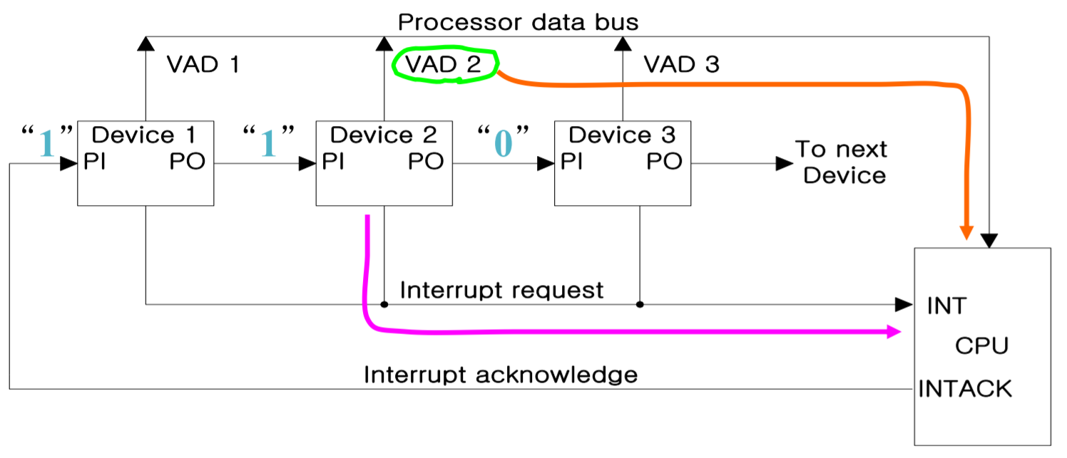
VAD is the address of the service routine which services that device.

Slide 68
Conclusion:
The daisy-chaining method involves connecting all the devices that can request an interrupt in a serial manner.
This configuration is governed by the priority of the devices.
The device with the highest priority is placed first followed by the second highest priority device and so on.
The device with PI = 1 and PO = 0 is the one with the highest priority that is requesting an interrupt, and this device places its VAD on the data bus.

Slide 69
Direct Memory Access (DMA)
DMA Controller(IC 8257),
DMA Transfer,
Intel 8089 IOP.
The transfer of data between a fast storage device such as magnetic disk and memory is often limited by the speed of the CPU.
Removing the CPU from the path and letting the peripheral device manage the memory buses directly

Slide 70
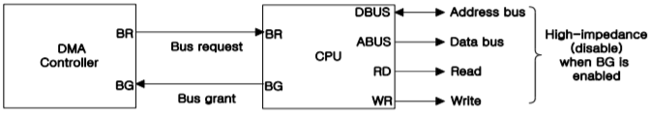
DMA Controller
DMA controller takes over the buses to manage the transfer directly between the I/O device and memory (Bus Request/Grant).
DMA Controller is a hardware device that allows I/O devices to directly access memory with less participation of the processor.

Slide 71
The DMA controller has three registers
Address register – It contains the address to specify the desired location in memory.
Word count register – It contains the number of words to be transferred.
Control register – It specifies the transfer mode.
All registers in the DMA appear to the CPU as I/O interface registers.
Therefore, the CPU can both read and write into the DMA registers under program control via the data bus.

Slide 72
How DMA Operations are Performed?
Following is the sequence of operations performed by a DMA −
Initially, when any device has to send data between the device and the memory, the device has to send DMA request (DRQ) to DMA controller.
The DMA controller sends Hold request (HRQ) to the CPU and waits for the CPU to assert the HLDA.
Then the microprocessor tri-states all the data bus, address bus, and control bus. The CPU leaves the control over bus and acknowledges the HOLD request through HLDA signal.
Now the CPU is in HOLD state and the DMA controller has to manage the operations over buses between the CPU, memory, and I/O devices.

Slide 73
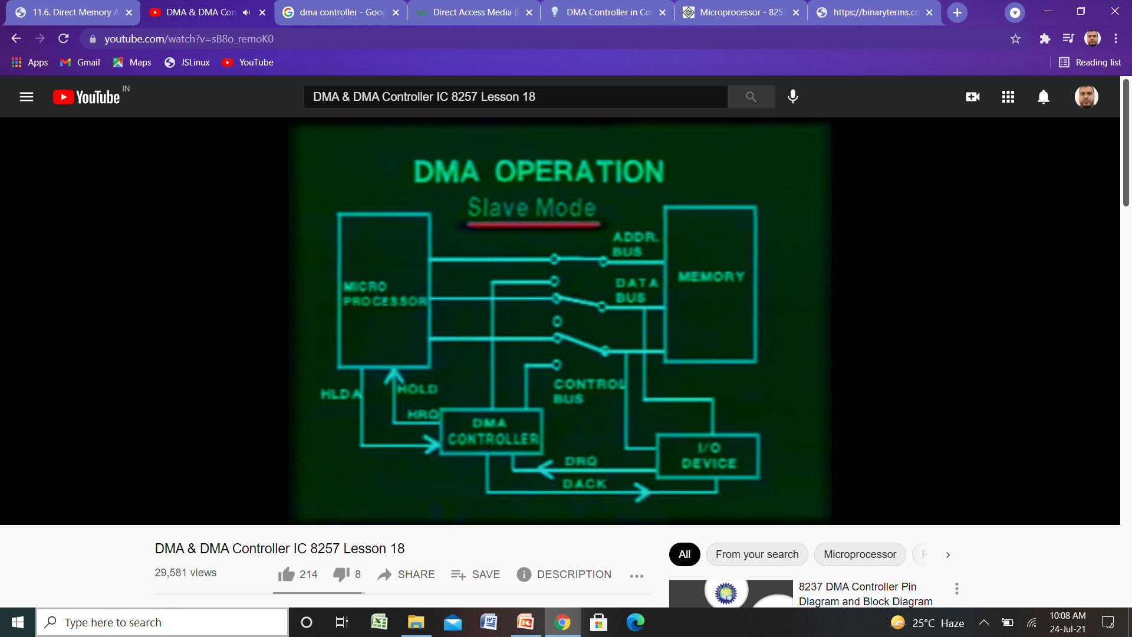
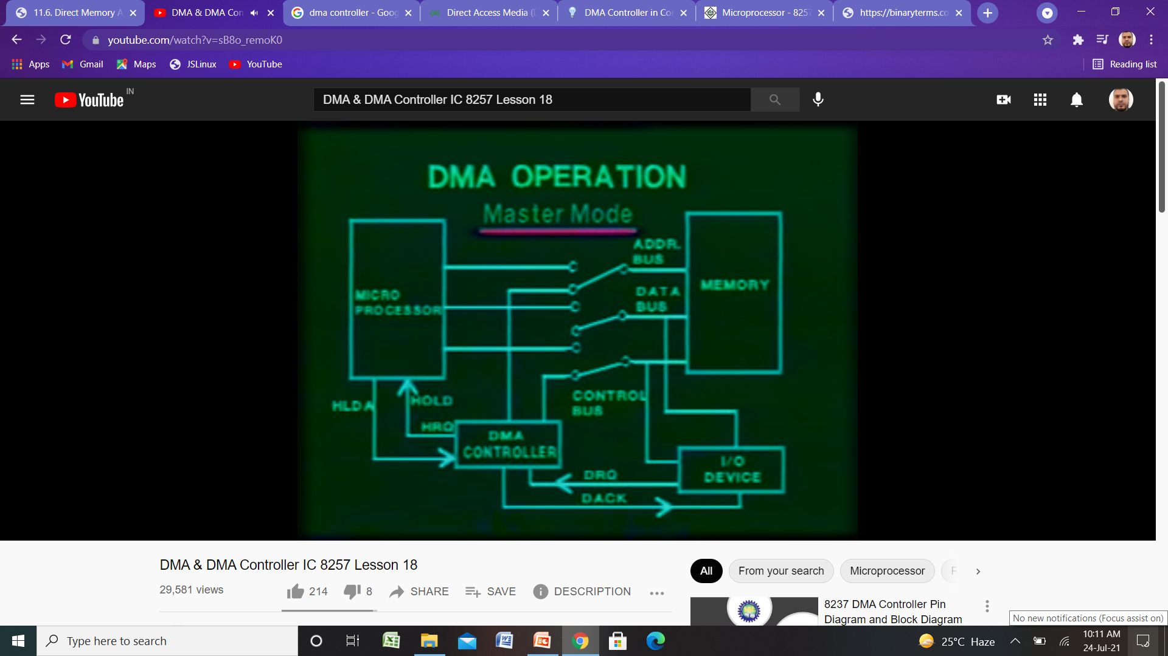
DMAC normally works in two different modes
Slave mode
CPU-DMAC interact
Master mode
DMAC connects memory with I/O

Slide 74
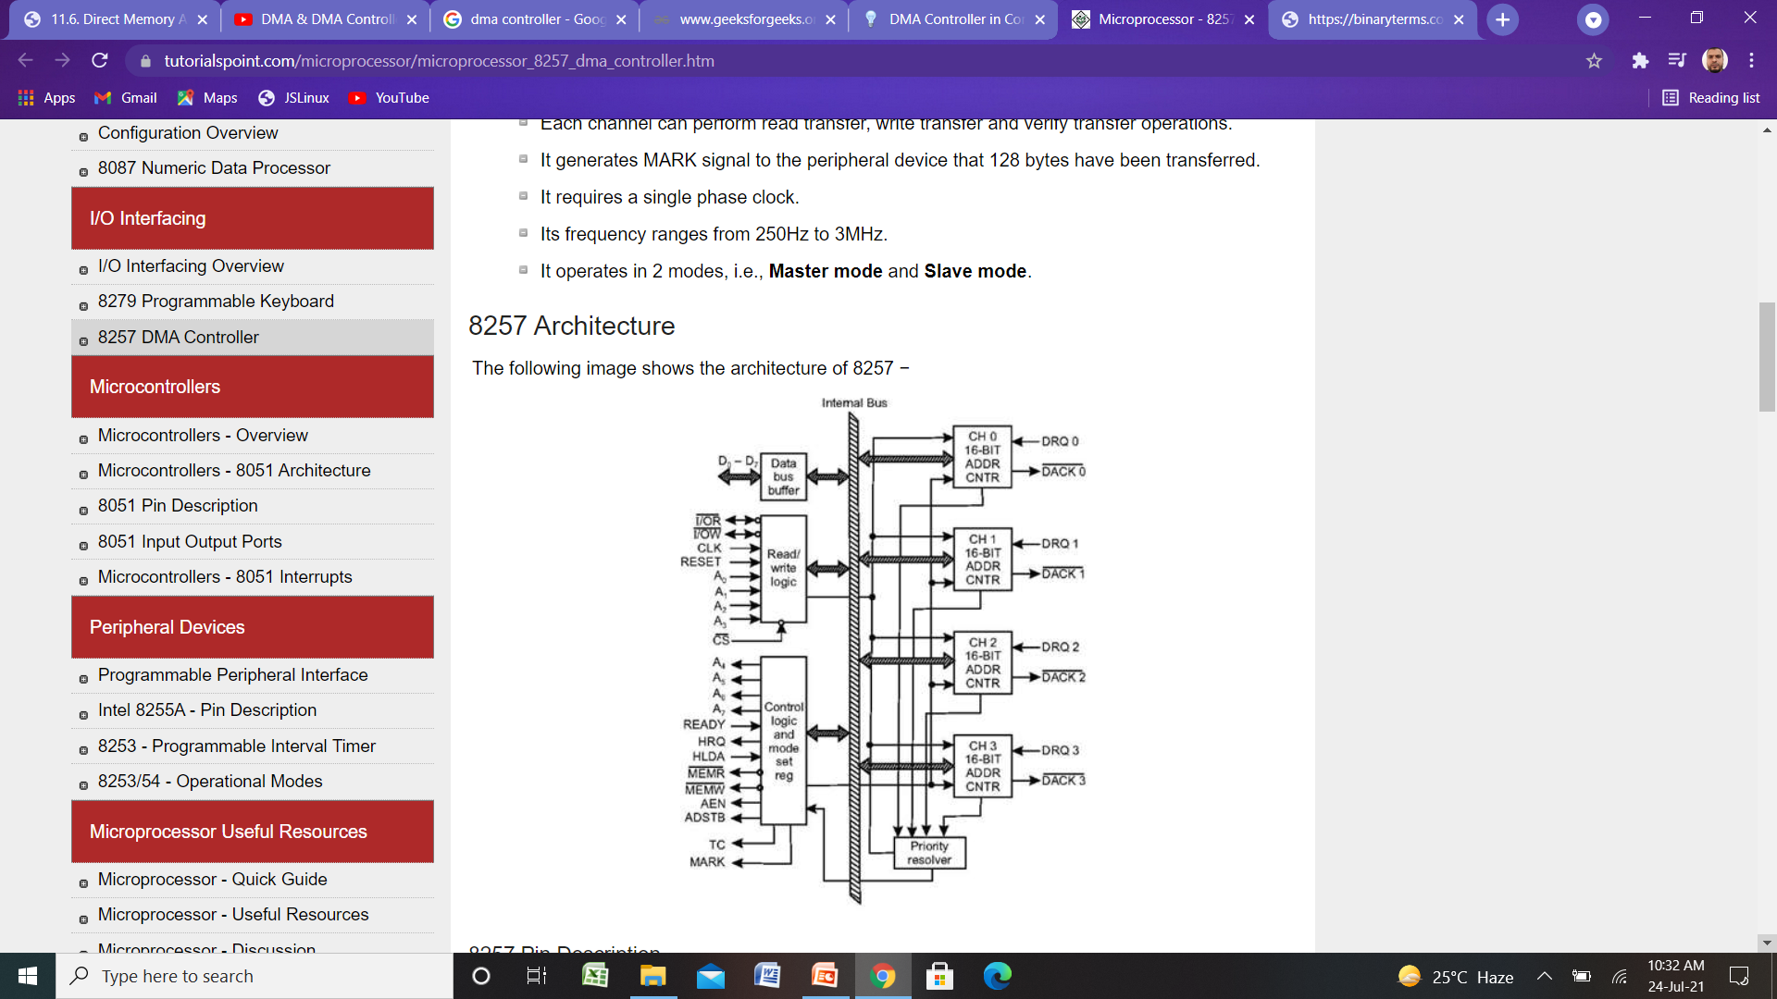
Architecture of DMA Controller (IC 8257)

Slide 75
DMA Transfer (I/O to Memory)
I/O Device sends a DMA request
DMAC activates the BR line
CPU responds with BG line
DMAC sends a DMA acknowledge to the I/O device
I/O device puts a word in the data bus (for memory write)
DMAC write a data to the address specified by Address register
Decrement Word count register
Word count register = 0, EOT interrupt CPU
Word count register ≠0, DMAC checks the DMA request from I/O device

Slide 76
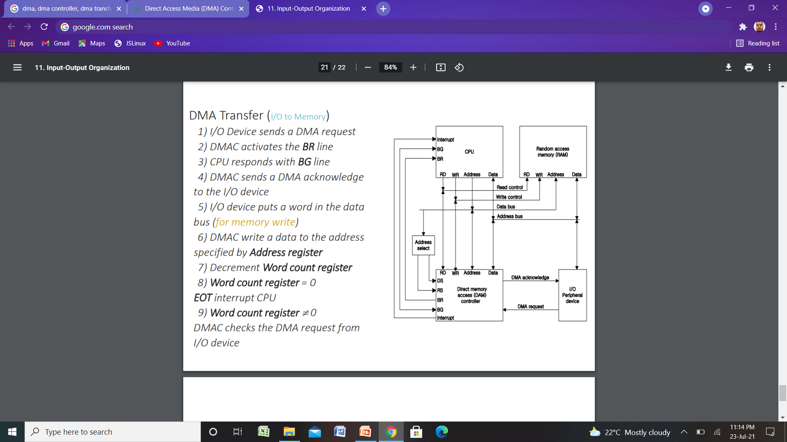

Slide 77
Intel 8089 IOP
A microcomputer system using the Intel 8086/8089 pair of integrated circuits is shown in below Figure.
The 8086 functions as the CPU and the 8089 as the IOP.
The two units share a common memory through a bus controller connected to a system bus, which is called a "multibus" by Intel.
The IOP uses a local bus to communicate with various interface units connected to I/O devices.
The CPU communicates with the IOP by enabling the channel attention line.
The select line is used by the CPU to select one of two channels in the 8089.
The IOP gets the attention of the CPU by sending an interrupt request.

Slide 78
